Slide 1

Real world whiteboard design session case study
Big data and visualization

Slide 2

Step 1: Review the customer case study

Slide 3
Customer situation
AdventureWorks Travel (AWT) provides concierge services for business travelers.
In an increasingly crowded market, they are always looking for ways to differentiate themselves and provide added value to their corporate customers.
Looking to capitalize on their existing data assets to provide new insights that provide them a strategic advantage against their competition.
Interested in using predictive analytics to help customers best select their travels based on the likelihood of a delay.

Slide 4
Customer situation
Customers often ask questions like, “I don’t have to be there until Tuesday, so is it better for me to fly out on Sunday or Monday?”
AWT believes an innovative solution might come in the form of giving the customer an assessment of the risk of encountering flight delays.
AWT plans to pilot this solution internally, whereby the small population of customer support who service AWT’s premium tier of business travelers would begin using the solution and offering it as an additional data point for travel optimization.

Slide 5
Customer situation
AWT has over 30 years of historical flight data provided to them by the United States Department of Transportation (USDOT).
They have a history of the historical weather condition for each flight as CSV files.
Weather forecasts require a call to a REST API.

Slide 6
Customer needs
Want to modernize their analytics platform, without sacrificing the ability to query their data using SQL.
Need an approach that can store all of their data, including the unmodified source data and the cleansed data from which they query for production purposes.
Want to understand how they will load their large quantity of historical data into Azure.
Need to be able to query the weather forecast and use it as input to their flight delay predictions.
Desire a proof of concept machine learning model that takes as input their historical data on flight delays and weather conditions in order to identify whether a flight is likely to be delayed or not.
Need web-based visualizations of the flight delay predictions.

Slide 7
Customer objections
Does Azure offer a machine learning solution that does not require a PhD in statistics?
We have heard that creating a machine learning model takes a month to build and another 2–3 months to operationalize so that it is useable from our production systems. Is this true?
Can we query flat files in the file system using SQL?
Does Azure provide anything that would speed up querying (and exploration) of files in HDFS?
Does Azure provide any tools for visualizing our data? Ideally access to these could be managed with Active Directory.

Slide 8
Customer objections
Are there any additional services in the Azure Marketplace we could use to identify data loaded that contains PII, monitor access to sensitive data and protect the data at rest (via encryption or masking)?
Is HDInsight our only option for running SQL on Hadoop solutions in Azure?
We have heard of Azure Data Lake, but we are not clear about whether this is currently a good fit for our PoC solution, or whether we should be using it for interactive analysis of our data.
We would like to limit access to our SQL DW using centralized Azure Active Directory accounts and groups. Is this possible? I thought I was limited to a user name and password.

Slide 9
Customer objections
We’d like our operationalized models to be flexible in the inputs they support. In some cases, we want to provide both the flight and weather data to get a prediction. In others we just want to provide flight data and have the weather looked up. Is this possible?

Slide 10
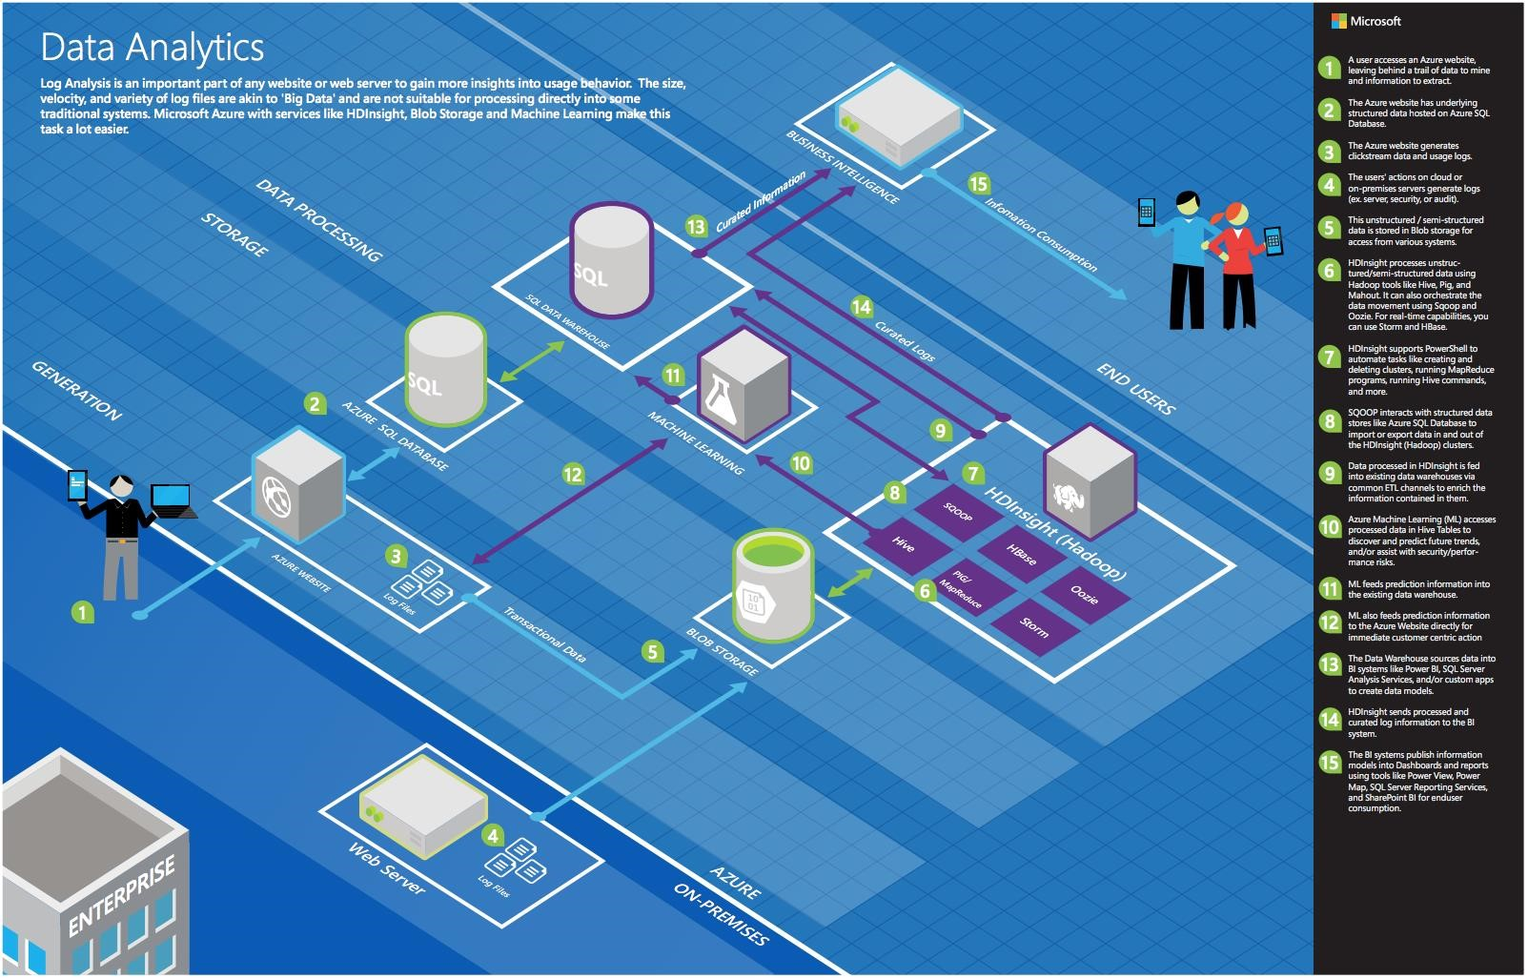
Common scenarios

Slide 11
Step 2: Call to action: Design the solution
Outcome
Design a solution and prepare to present the solution to the target customer audience in a 15-minute chalk-talk format.
Timeframe
60 minutes
Business Needs (10 minutes) | Respond to questions outlined in your guide and list the answers on a flipchart.
Design (35 minutes) | Design a solution for as many of the stated requirements as time allows. Show the solution on a flipchart.
Prepare (15 minutes) | Identify any customer needs that are not addressed with the proposed solution. Identify the benefits of your solution. Determine how you will respond to the customer’s objections. Prepare for a 15-minute presentation to the customer.

Slide 12
Step 3: Call to action: Present the solution
Outcome Present a solution to the target customer audience in a 15-minute chalk-talk format.
Timeframe
30 minutes (15 minutes one team, to present and receive feedback.)
Directions
Pair with another table.
One table is the Microsoft team and the other table is the customer.
The Microsoft team presents their proposed solution to the customer.
The customer asks one of the objections from the list of objections in the case-study.
The Microsoft team responds to the objection.
The customer team gives feedback to the Microsoft team.

Slide 13
Wrap-up
Outcomes
Identify the preferred solution for the case study.
Identify solutions designed by other teams.
Timeframe
15 minutes

Slide 14
Preferred target audience
Jack Tradewinds, CIO of AdventureWorks Travel (AWT)
The primary audience is business decision makers and technology decision makers.
Usually we talk to the Infrastructure Managers who report to the CIOs, or to application sponsors (like a VP LOB, CMO) or to those that represent the Business Unit IT or developers that report to application sponsors.

Slide 15
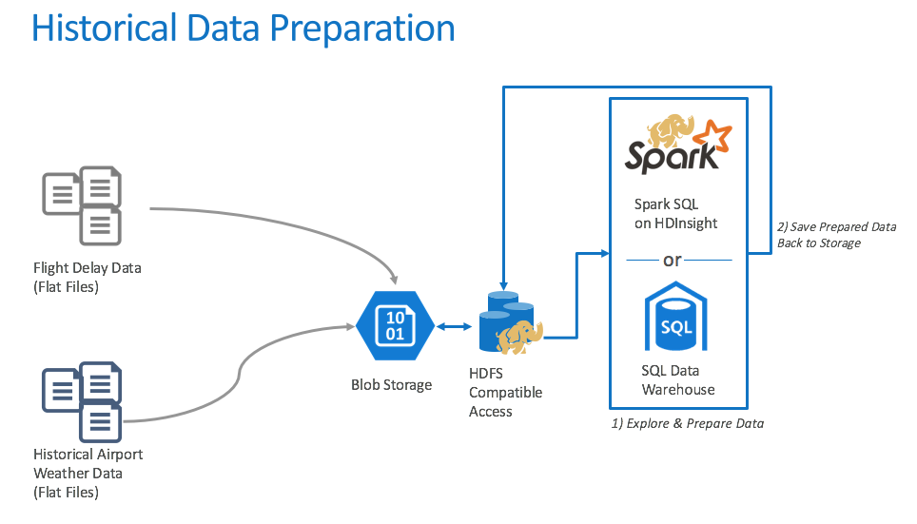
Preferred solution

Slide 16
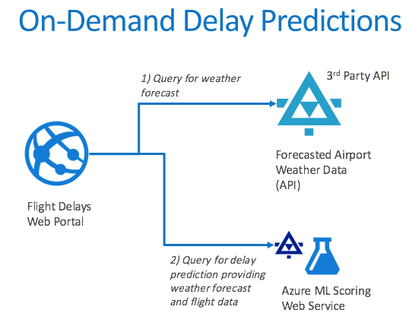
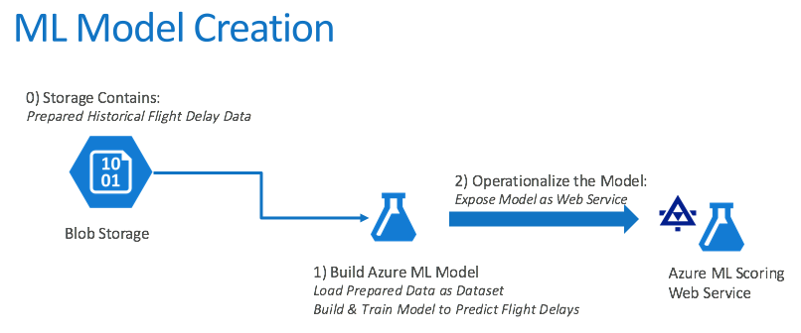
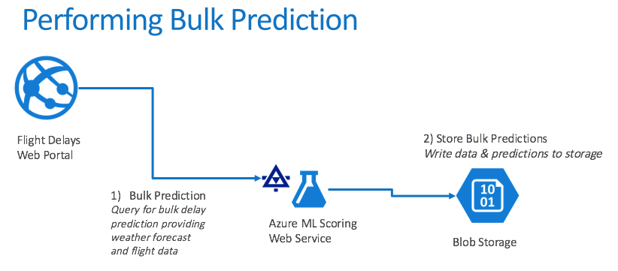
Preferred solution

Slide 17
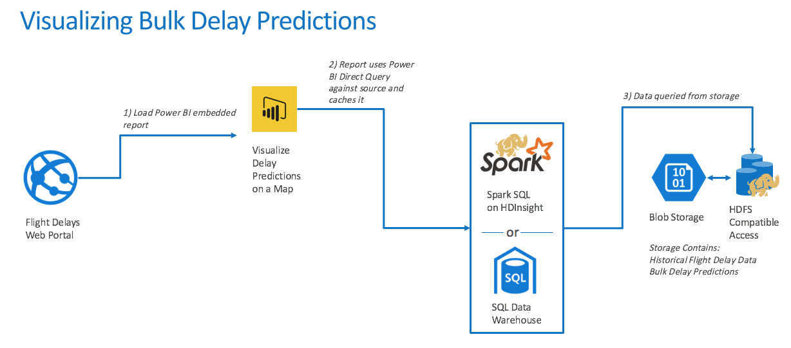
Preferred solution

Slide 18
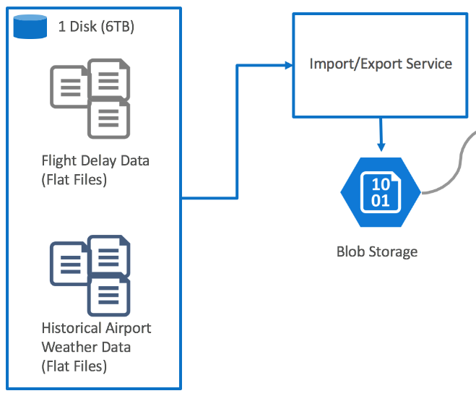
Preferred solution
Data loading
How would you recommend that AWT get their historical data into Azure? What services would you suggest and what are the specific steps they would need to take to prepare the data, to transfer the data, and where would the loaded data land?
AWT should consider using the Microsoft Azure Import/Export service.
With this service they could ship their entire historical data in a single 6 TB disk.
To prepare for this transfer, they would need to create an Azure Storage account and acquire an external 3.5-inch SATA II or SATA III drive that has a maximum size of 10 TB. They could attach this disk internally to a machine or via a SATA II/III USB adapter to a machine on their network that can access the files.
They would have to format the drive with NTFS.
Then they would load the data using the Azure Import/Export tool.
After that, they would need to upload the generated journal files using the existing Azure Portal, and then ship the drive.
Upon receipt, their files are loaded into the configured blob storage account.

Slide 19
Preferred solution
Data Preparation
What service would you recommend AWT capitalize on in order to explore the flat files they get from the United States Department of Transportation (USDOT) using SQL?
They could use either HDInsight or SQL Data Warehouse (SQL DW), as both provide support for SQL over HDFS (Hadoop Distributed File System).
If you suggested HDInsight, what specific configuration would you use? What components of the Hadoop stack would you use to allow AWT analysts to query and prep the data? How would they author and execute these data prep tasks?
They should use Spark SQL.
They would need to create the appropriate external tables atop the flight delay files available in HDFS, which reads from the Azure Storage account attached to their HDInsight instance.

Slide 20
Preferred solution
Data Preparation
If you suggested SQL Data Warehouse, explain how you would configure the SQL DW instance.
They could query the files in HDFS using PolyBase. They would need to create the appropriate external tables atop the flight delay files available in HDFS, which actually live in the Azure Storage account that is registered with their SQL Data Warehouse instance.
Why did you recommend HDInsight over SQL Data Warehouse or vice versa?
All other items being equal, the customer expressed interest in using SQL Data Warehouse to query their data. Therefore, using SQL Data Warehouse would likely be preferred by AWT.
How would you suggest AWT integrate weather forecast data?
They could retrieve the weather forecast data from a third-party service that provides a REST API. An example of such a service is weatherunderground.com.

Slide 21
Preferred solution
Machine learning modeling
What technology would you recommend that AWT use for implementing their machine learning model?
Azure Machine Learning (Azure ML).
How would you guide AWT to load data so it can be processed by the machine learning model?
The data used for training would need to be uploaded into a dataset or accessed using the Reader module from Azure Storage blobs. Some amount of data preparation work would need to be done first using Spark to create a subset of the data that is used for training and validation.
What category of machine learning algorithm would you recommend to AWT for use in constructing their model? For this scenario your options are clustering, regression or two-class classification. Why?
Given that AWT only wants a binary prediction of flight delayed or flight not delayed, they should proceed with a two-class classification algorithm.

Slide 22
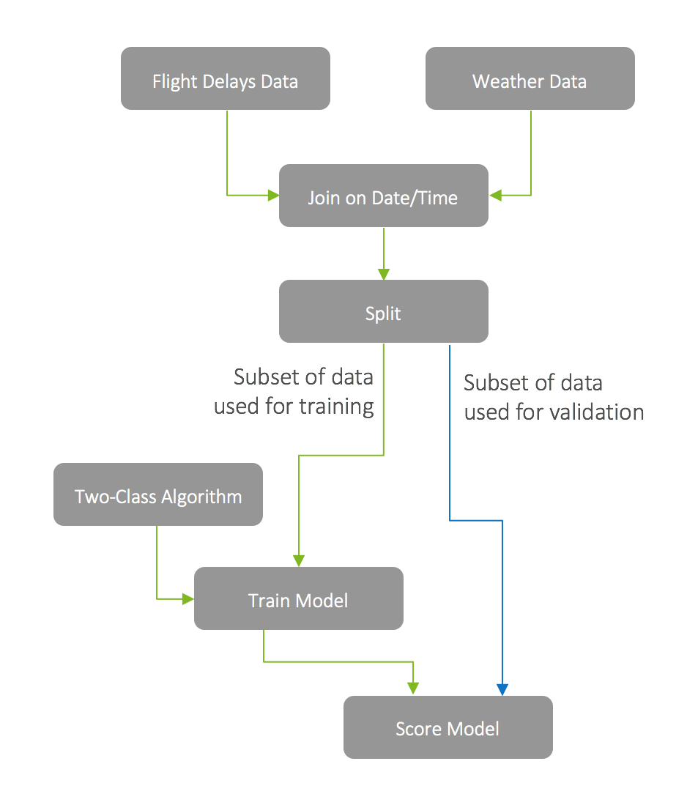
Preferred solution

Slide 23
Preferred solution
Machine learning modeling
What attributes of the flight and weather data do you think AWT should use in predicting flight delays? How would you recommend that AWT identify the columns that provide the most predictive value in determining if a flight will be delayed? Be specific on the particular modules or libraries they could use and how they would apply them against the data.
Start with any domain knowledge they have—this would likely point in the direction of the flight attribute’s airline, departure airport, destination airport, and time of day as well as the weather attribute’s wind speed, temperature, and precipitation conditions.
Additionally, they should use the Evaluate Statistics module to identify and remove fields that do not add value (for example, because they are mostly empty or only have a constant value).
Construct a preliminary model and validate how it performs against the training data.
In additional passes, they might choose to use the Feature Selection modules or the Principal Component Analysis module that statistically rank the fields that provide the greatest predictive value against the training data.

Slide 24
Preferred solution
Machine learning modeling
Some of the data may need a little touching up: columns need to be removed, data types need to be changed. How would these steps be applied in your model?
Using Data Manipulation modules such as Clean Missing Data and Apply SQL Transformation.
Also, the Metadata Editor, Apply Math Operation, and R Script modules.
How would you recommend AWT measure the success of their model?
For a classification model, measure the success of their model against a data set whereby a large portion of the data is used for training purposes.
A smaller set is reserved as examples that will be used to “test” the model to see how it performs against a known outcome.
The output of the prediction as well as the “correct” output is passed to the Evaluate Model module which provides scores such as those from the Confusion Matrix that give a perspective on accuracy and in what situations the models makes mistakes.
A more sophisticated validation model could involve using an ensemble approach, such as that provided by the Cross Validate Model module which takes multiple passes through the input data set to ascertain the performance.

Slide 25
Preferred solution
Operationalizing machine learning
How can AWT release their model for production use and avoid their concerns about extremely long delays operationalizing the model? Be specific on how your model is packaged, hosted, and invoked.
Use ML Studio to create a Predictive Web Service around it.
This will package the scoring function of the model so that it can be invoked via a REST call that takes the weather conditions and flight information as input and returns a response with the classification.
The service is hosted by Azure ML.

Slide 26
Preferred solution
Operationalizing machine learning
AWT has shown interest in not only scoring a flight at a time (based on a customer’s request), but also doing scoring in large chunks so that they could show summaries of predicted flight delays across the United States. What changes would you need to make to your ML model to support this?
Use Azure ML’s Batch Execution API.
This requires them to have uploaded the examples they want scored to Blob storage, and after processing the scored result will be available in Blob storage also.
It would not require any changes to their ML model, but they would have to use the Batch Execution API to submit a batch job, start a batch job, get job status, and retrieve job status (which when finished provides the output location of batch scored data).

Slide 27
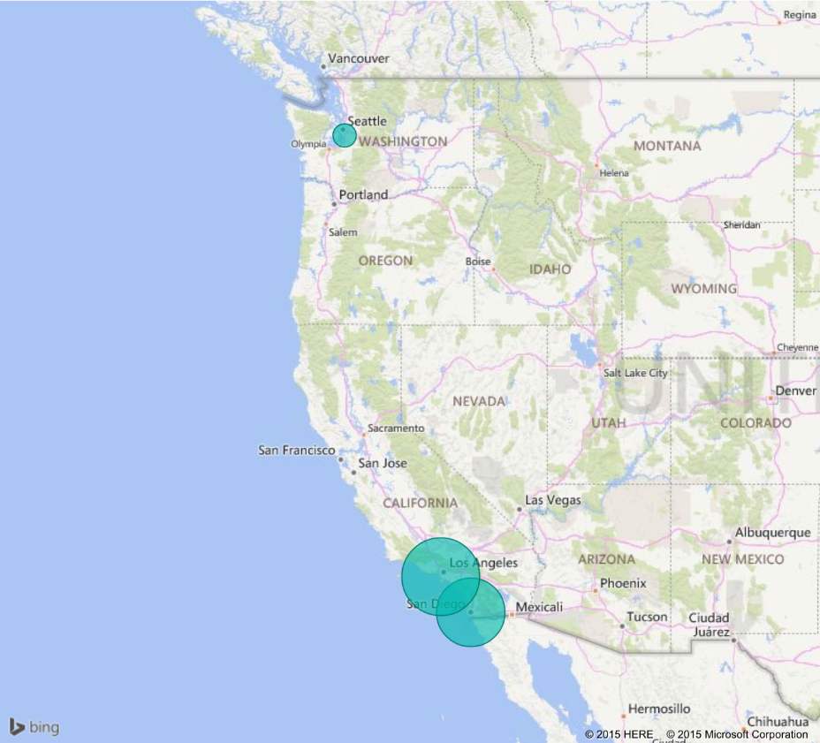
Preferred solution
Visualization and reporting
Is Power BI an option for AWT to use in visualizing the flight delays?
Yes, Power BI is a good option for AWT.
How would AWT load the data and plot it on a map? What specific components would you use and how would you configure them to display the data?
The data would be set up as a query against Spark or SQL Data Warehouse that loads the predicted flight delay for each airport location.
They would use the map visualization to display a delay indicator for a particular flight at a particular airport.

Slide 28
Preferred solution
Visualization and Reporting
If they need to make minor changes, such as a change to the data types of a column in the model, how would they perform this in Power BI?
They could do this using the Query Editor component of the Power BI Desktop application. They could then upload this file to the Power BI service.
How could they secure access to these reports to only their internal customer service agents?
By utilizing the Power BI service, they can create a Content Pack that contains only the desired dashboards, reports, and datasets and restrict access to those groups in Azure Active Directory to which the customer service agents belong.

Slide 29
Preferred objections handling
Does Azure offer a machine learning solution that does not require a PhD in statistics?
Yes. Azure Machine Learning provides tools that are powerful enough for the data scientist, but are approachable by the developer.
We have heard that creating a machine learning model takes a month to build and another 2–3 months to operationalize so that it is useable from our production systems. Is this true?
This is true in the traditional process for creating machine learning models, whereby the data scientist creates a model (for example, in R) and then hands it over to developers who translate it into Java or C#—which can take months to get the translation correct and performant. With Azure ML, operationalizing a model is done by converting a scoring experiment into a Web service, which takes only a few clicks.
Can we query flat files in the file system using SQL?
Yes. There are many options for using a SQL syntax to query files in Blob storage such as SQL Data Warehouse and HDInsight with Spark SQL or Hive.

Slide 30
Preferred objections handling
Does Azure provide anything that would speed up querying (and exploration) of files in HDFS?
Yes. SQL Data Warehouse provides the ability to create indices on flat file content, as does Hive on HDInsight. Spark SQL on HDInsight provides a distributed in-memory cache that can aid exploratory queries that often repeat queries against the same subsets of data.
Does Azure provide any tools for visualizing our data? Ideally access to these could be managed with Active Directory.
Power BI is available as a service and provides tools for creating both dashboards and reports whose access can be restricted by group membership in Azure Active Directory.

Slide 31
Preferred objections handling
We’ve heard of Azure Data Lake, but we’re not clear if this currently a good fit for our PoC solution, or if we should be using it for interactive analysis of our data.
Azure Data Lake Analytics provides a distributed querying engine whose costs are based solely on the number of resources used in the query, the amount of time those resources were made available to the query and a nominal job completion charge.
In its current Preview form, Azure Data Lake Analytics supports only Batch workloads, so it is not the right tool for interactive analytic workloads.
Azure Data Lake Store provides the ability to store an unlimited number of items, each of unlimited size, having no upper limit on the total storage capacity.
In the long run, Azure Data Lake Store is where the customer should consider landing all of their data, but for the purposes of the PoC using Azure Blob Storage is the easier to implement because of its built-in support from the portal.

Slide 32
Preferred objections handling
Are there any additional services in the Azure Marketplace we could use to apply data-centric security—that is to identify data loaded that contains PII, monitor access to sensitive data and protect the data at rest (via encryption or masking)?
DataGuise provides the DGSecure product line that provides support for the automated detection of sensitive information at the time of data ingest by means of its DGSecure Ingest Agents (which include agents for relational databases, FTP and Apache Flume).
Sensitive information can also be identified after it is stored in HDFS or Blob by using a Hadoop or HDInsight cluster to run periodic map/reduce scans for sensitive data on disk. The actions taken after discovery of sensitive data can range from flagging the data sensitive (for monitoring and notification purposes), to modifying the data where the sensitive data is masked or encrypted and then updated in the data store.
DGMonitor provides the ability to centralize monitoring of access to sensitive data, as well as raising alerts when suspicious activity is detected.

Slide 33
Preferred objections handling
Is HDInsight our only option for running SQL on Hadoop solutions in Azure?
No. Hortonworks , Cloudera and MapR provide fully supported distributions that are available in the Azure Marketplace and provide environments for running HiveQL and Spark SQL in Azure.
We would like to limit access to our SQL DW using centralized Azure Active Directory accounts and groups. Is this possible? I thought I was limited to a user name and password.
It is possible to authenticate to SQL Data Warehouse with an AAD account. Furthermore, you can restrict access to members of certain AAD groups. However, there are certain limitations, such as PolyBase being unable to use AAD for authentication. Also, there is currently no way to use AAD authentication to SQL DW from Power BI.

Slide 34
Preferred objections handling
We’d like our operationalized models to be flexible in the inputs they support. In some cases, we want to provide both the flight and weather data to get a prediction. In others we just want to provide flight data and have the weather looked up. Is this possible?
Yes. It is possible to add multiple web service input modules to the experiment, allowing you to add multiple sources, joining them at runtime or processing them separately.

Slide 35
Customer quote
“We are flying into the future with Azure, helping our customers more aggressively schedule their travel, and optimize their non-travel time.”
Jack Tradewinds, CIO of AdventureWorks Travel

